Slide 1
Automation Document Processing Update June 24th - release v2201 Daniel Ouimet Global technical sales program - capture douimet@ca.ibm.com t: 1-514-213-8850

Slide 2















Regardless of where documents come from, you can unlock the data you need inside by applying intelligence.
Use this data in automation services to optimize your workforce.
IBM Capture can unlock data from inside your documents to make better decisions faster and drive business performance.
Digitize work
Scan
Email
Fax
Files
RPA
Apply Intelligence
Classify
Read Data
Self- learning
Optimize the workforce
Content Repositories
App 1
App 2
Digital worker
Workflow
RPA
IBM Automation / © 2021 IBM Corporation
2
Notes:
Here’s what an information capture solution does…
It is a software solution that can integrate with a wide range of content sources, but mostly electronic of paper documents. This automates the digitization and normalization all information sources for reliable and consistent accessibility and intelligent processing.
At the heart of an information capture solution is the is ability to automatically classify the context of the information, extract specific information and the verify and validate that information in a consistent and rigorous manner. This is where AI and other software methods are applied to identify the actionable information within each piece source of content.
Integration with other applications like IBM FileNet Content Manager, RPA bots, ERP and CRM solutions or a Digital Worker allows the capture solution to deliver the refined information exactly where your workforce needs to activate it.

Slide 3
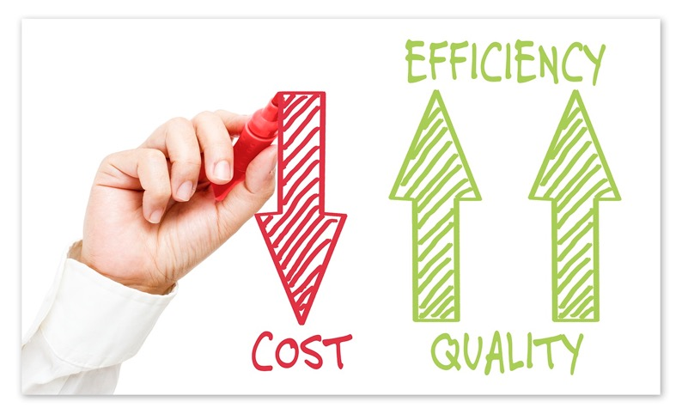

Three business priorities are driving today’s decisions
Adapt to Market Changes Quickly
Mass scale personalization and deep engagement with customers
Hard to access data and content to enable more accurate responses and insights
Increase Operational Efficiency
Drive efficiency by streamlining how documents are classified
Accelerated processing to execute flows
Solutions that are Simple to Deploy, Use, and Improve
Need to decrease lead times as much as possible to keep everything running
Need better results over time
Notes:
There are many business priorities for leaders in the market today. However, consistently every year, there are three that tend to top the list to drive decisions.
First is Agility – being able to adapt to market conditions and stay ahead of the competition. Whether through personalization of products and services or being able to take in content and data from various sources that are not easily accessible via regular channels.
Second is Efficiency – We are being asked to make our content and data more directly accessible and classified in order to better feed into our processes, all this to facilitate workflows and automations.
Third, Solutions that are Simple to Deploy, Use, and Improve – With changing and evolving markets, we need to be able to decrease lead times as much as possible for new applications and Automations. Additionally, we don’t want our systems to lose their efficiencies with changes, we need results that in fact improve over time.
--=== COACHING NOTES -- DELETE BELOW THIS LINE ==--
PURPOSE: The purpose of this slide is to introduce the 3 business priorities behind document processing.
PROBING QUESTION: "Specific to your business, how do these business priorities align with yours? If you were to prioritize them, what would be the order”
--=== DELETE ABOVE THIS LINE ==--

Slide 4

An intelligent capture solution needs more than high-accuracy OCR. AI provides the understanding that finds and pulls actionable information from content
Extract valuable information AI provides the ability to automatically recognize extract critical information.
Train a deep learning model on what information is most valuable to your business, then continue building and scaling your systems accordingly.
Data Validation + Increased Decision Accuracy
AI provides the framework to deal with exceptions consistently, accurately, and at scale.
Speed up quality assurance, error and omission detection, and overall exception handling in an effective and timely manner.

Slide 5
How IBM’s intelligent capture software automates document-driven business processes:
Ingestion
Documents are gathered, digitized if they are physical documents, then pre-processed to improve recognition rates
Categorization
Sort documents into the appropriate category and enhance their metadata
Routing, Approvals, and Exception-Handling
Increased accuracy due to human-in-the-loop validation
Optical Character Recognition (OCR)
Convert images to machine-readable text via one or more OCR engines
Data Extraction and Validation
Process documents for distribution and archiving (extract key information, redact sensitive data) with a rules-based approach or using AI
Publishing
Send the output to apps and databases (e.g. FileNet, Content Manager 8, Content Manager OnDemand, Microsoft SharePoint)

Slide 6

Document processing - the challenge
Challenges
Decisions need to be made quickly based on information that is buried in documents. Getting information takes a lot of time, effort, and multiple applications
Each source of information / documents is unique due to differences in form factors, users, workflows, environments, and use cases
A company may already have a traditional capture solution in place and need to expand its capabilities quickly
Takes months to onboard new forms
Typical example
When a bank has multiple types of account servicing forms to make changes to customer accounts they might:
Enlist a sizable team of agents to read submitted forms and verify the data, then manually enter the data into the bank’s account management systems
Use a custom-built application from their IT department with embedded rules
Notes:
Enterprises are continuously challenged to reduce costs of manual document processing.
And meeting the needs of the larger volumes of data can be time consuming, and low skilled.
We now have a need to understand structured and unstructured documents while digitizing, extracting and storing data from those documents.
And in the need to improve accuracy and efficiency of current solutions, techniques such as zoning and fingerprinting are not enough.
Here we have a typical example for a bank.
Regardless of where documents come from, you can unlock the data you need inside by applying intelligence. This data can be used in automation services to optimize your workforce.
--=== COACHING NOTES -- DELETE BELOW THIS LINE ==--
PURPOSE: The purpose of this slide is to introduce how most businesses are traditionally handling “Document Processing”
PROBING QUESTION: "Specific to your business, how are you currently processing unstructured documents, and from what types of sources?”
POTENTIAL ANSWER YOU MAY HEAR FROM CLIENT: “Through various channels, such as email attachments, Fax, or sent by courier from various branches”
OPTIONAL POINTS:
Speaker – List some of the examples below to make it feel more real to the audience.
Paper and digital images of checks that require verification
A PDF vendor invoice that comes into your accounting department’s email; Roughly two-thirds of all businesses issue PDF invoices via email, but less than 20% structured e-invoices. (https://compacer.com/wp-content/uploads/2019/05/Billentis_Report_compacer_single-sponsor.pdf p.28)
Census data released by the government that has demographic information about customers
Company social media feed that customers interact with, such as with questions, comments, and sentiments.
A product photo that gets associated with an order;
A bar code that is assigned to an item in your warehouse;
A doctor treating a patient needs more than a patient's written records--she might also require x-rays, MRIs, and other types of imagery;
A police officer wants to be able to call up a photo of a possible suspect, as well as the suspect's driving record; and
A surveyor mapping a section of land needs more than his own measurements; he combines this data with satellite and topographical imagery that enhances his work.
--=== DELETE ABOVE THIS LINE ==--

Slide 7
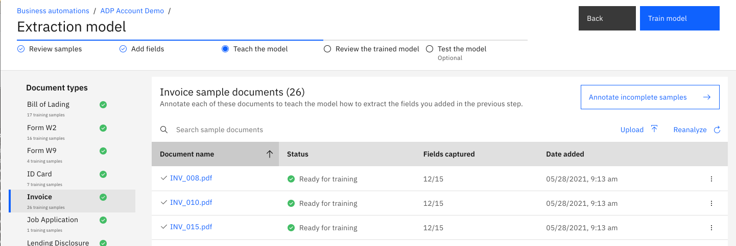
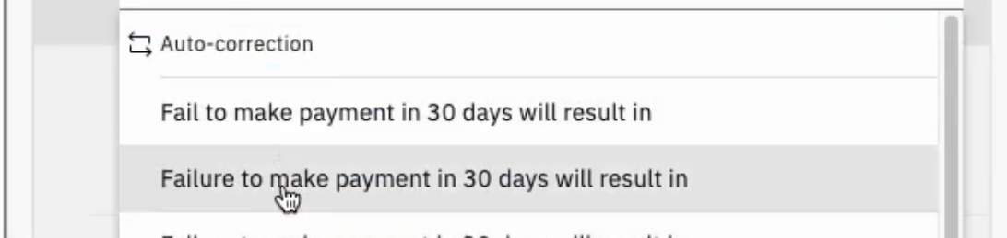
Document processing - the solution (Automation Document Processing)
Document processing
A no-code set-up experience means that you can build the document processing applications you need without a data scientist
Extract data from structured, semi-structured, and unstructured documents
Automatically detect and correct data that has been extracted incorrectly or should be enriched
How it works
Create a document processing project and flow with a visual, step-by-step click-through approach to building applications
Jump-start the document training process by reading common fields like, “Customer Address,” or, “Account Number,” or directly reading PDF form definitions
The AI is also smart enough to handle documents it hasn’t encountered before, since it doesn’t rely on the location of fields in documents to get the information it needs
Out of the box way to invoke workflows, decisions and other automation services from document processing low-code applications
Outcomes
Set-up to deployment won’t take months to complete
Easily customize a template that is relevant to your documents and scenario with consistent low-code user interface design skills from across the solution
Faster customer response times or time-to-quote by reducing manual processing and saving cost in staffing
Extract data from forms, statements, & unstructured documents
Determine whether a document has been signed or a box has been checked
Automatic data correction and suggestion of alternative data values
Notes:
With document processing, a no-code design tool is used for setting up data extraction which means you don’t need a data scientist or someone from engineering to set up your document processing applications. Using our intuitive and easy to use tooling which shows step-by-step flow, anyone can set up document processing apps so you can extract data from structured, semi-structured as well as unstructured documents. Document processing can also automatically detect and correct data that may be incorrect or should be refined without manual human intervention.
As you can see in the screenshots, document processing designer shows step by step flow on what needs to happen next to set up your applications. Business users create a document processing project to manage the flow and control access from other business automation projects. If implementing other project types, such as workflows or decisions, the project management and even some of the editing skills are shared across the Cloud Pak for Business Automation platform.
With document processing providing out of the box Machine Learning (ML) model, your training process can be accelerated as common fields can be read automatically and fields in PDF form definitions can be directly read. Even if the document type has not been seen before, our AI is smart enough to extract some data automatically as we provide AI-powered extraction instead of location-based template approach.
This means your set-up to deployment time is significantly reduced by using our document processing designer for setting up the design time and application designer templates for easily building and customizing the UI. With automatic document classification and data extraction in our no code environment, you can significantly reduce the manual human processing as humans will only need to look at data that falls below a certain threshold. With the ability to train your documents as you go, the efficiency of the solution improves every time it is used. Human in the loop is still there when needed, but skilled workers are increasingly released from these tasks, and become more active on where their skills are actually needed.
Acronyms:
ML = Machine Learning
--=== COACHING NOTES -- DELETE BELOW THIS LINE ==--
PURPOSE: The purpose of this slide is to introduce how most businesses are traditionally handling “Document Processing”
POTENTIAL QUESTIONS/OBJECTION YOU MAY HEAR FROM CLIENT: “But don’t we have to continuously manage the applications to adapt to new types of documents?”
SELLER SUGGESTED ANSWER/RESPONSE:
This is why AI is so important to address these evolving changes. The more you use this solution, the more it learns, and the better it is to adapt without having to develop new applications.
AI doesn’t look for sections in your document, it’s looking for information. It has the ability of understanding the document and extract what is relevant.
POTENTIAL QUESTIONS/OBJECTION YOU MAY HEAR FROM CLIENT: “Is the Machine Learning / Deep Learning done locally or on the cloud?”
SELLER SUGGESTED ANSWER/RESPONSE:
This solution can be hosted on your own cloud as a Kubernetes container. So all the processing is done locally, which means resource allocations are dedicated to your own environment.
OPTIONAL POINTS:
Speaker – List some of the examples below to make it feel more real to the audience.
Paper and digital images of checks that require verification
A PDF vendor invoice that comes into your accounting department’s email; Roughly two-thirds of all businesses issue PDF invoices via email, but less than 20% structured e-invoices. (https://compacer.com/wp-content/uploads/2019/05/Billentis_Report_compacer_single-sponsor.pdf p.28)
Census data released by the government that has demographic information about customers
Company social media feed that customers interact with, such as with questions, comments, and sentiments.
A product photo that gets associated with an order;
A bar code that is assigned to an item in your warehouse;
A doctor treating a patient needs more than a patient's written records--she might also require x-rays, MRIs, and other types of imagery;
A police officer wants to be able to call up a photo of a possible suspect, as well as the suspect's driving record; and
A surveyor mapping a section of land needs more than his own measurements; he combines this data with satellite and topographical imagery that enhances his work.
--=== DELETE ABOVE THIS LINE ==--

Slide 8

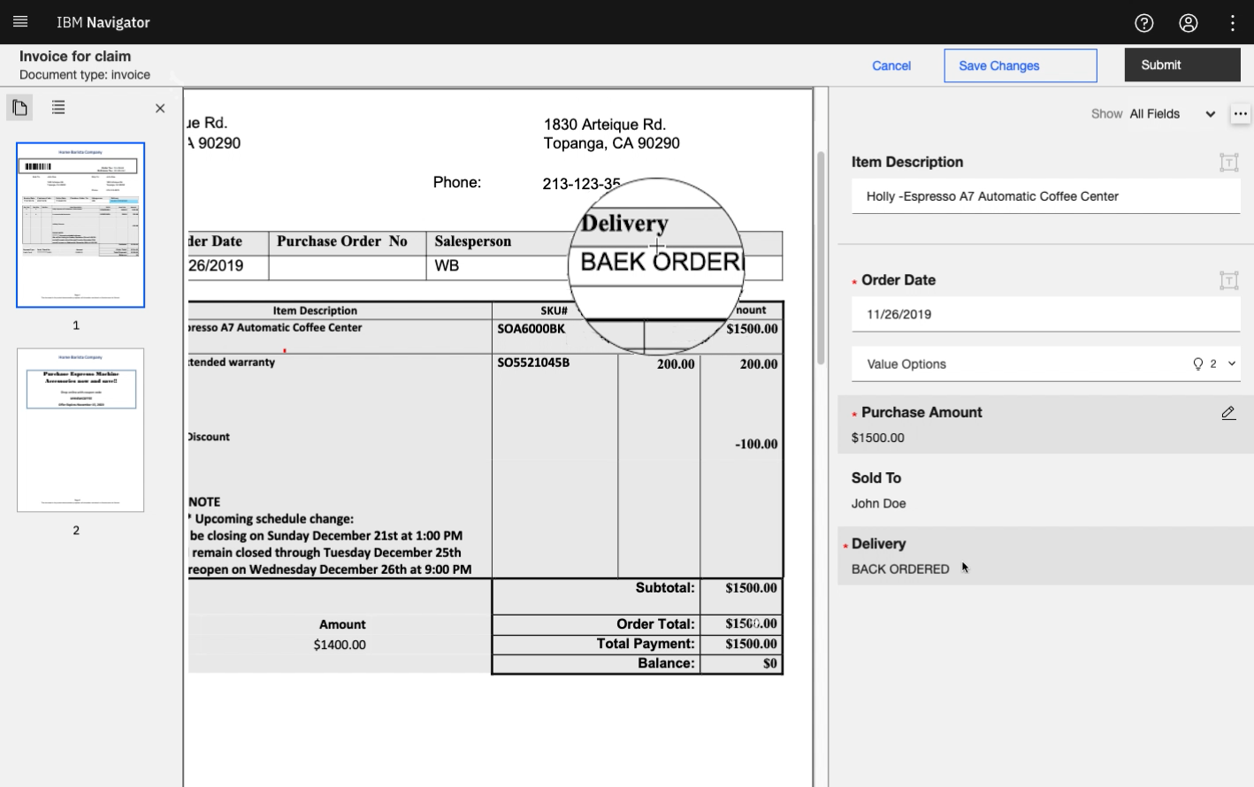
Intelligent document processing is essential
Automation Document Processing and Datacap work together! greater
Automation Document Processing Document processing for the Cloud Pak for Business Automation
Intelligent Extraction
Classification
Computer Vision
AI / ML
Cloud Native
Data Enrichment
Human-in-the-Loop Validation
Low-Code App Building
IBM Datacap For specific use cases or in combination with Automation Document Processing
Capture workflow / orchestration
Fax, email, scanning, file upload, folder scanning
File format normalization
Document separation
Handprint, cursive recognition
ID Processing
Expanded language support
Unlimited extensibility via APIs
Automated conversion of unstructured content from high volumes of documents to structured data for use in business processes
IBM Automation / © 2021 IBM Corporation

Slide 9
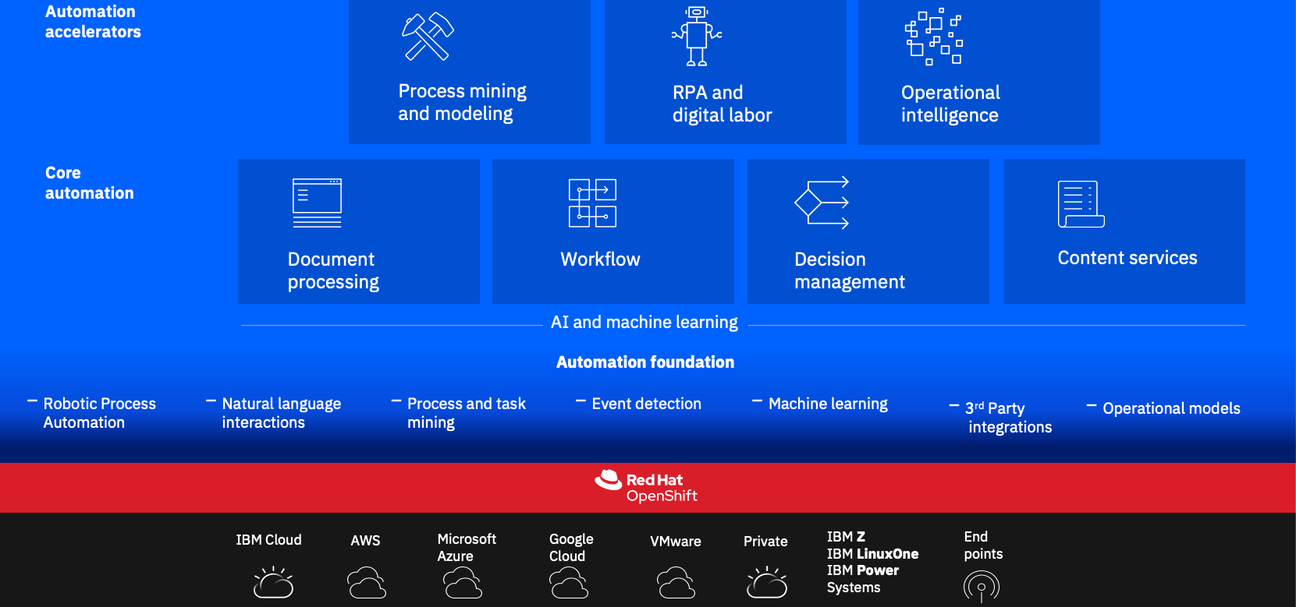
Intelligent capture can be combined with other capabilities to extract more business value
Examples include:
Deliver structured information at scale to RPA bots and processes
Feed documents, images, and emails with structured information for archiving, collaboration, and case management activities
Enrich existing content, like objects and records
Apply business rules and actions when specific content is identified within a document, such as redacting personally identifiable information
Extract information from unstructured sources to trigger or complete steps within a workflow
Client and Partner Solutions
Low-Code Applications

Slide 10
Keys concepts in latest release of ADP v22.0.1 – June 24th
Increase accuracy
Improve performance
Make it easier to use/train
Accelerate time to value

Slide 11
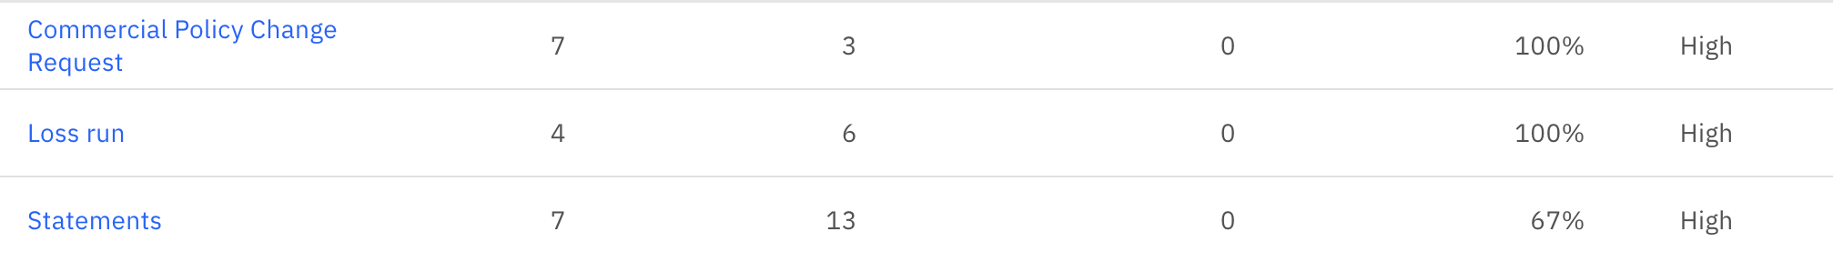
Extraction improvements
Fixed forms
Can define type as fixed form
Immediate learning
Faster to proof
High extraction % in minutes
ID Docs
- GA of the data extraction from identify docs
Tables
Much improved table extraction
More flexible table annotation capabilities
Varying line lengths, no need for lines between line items etc

Slide 12

Performance improvement
100% faster processing times
< 30 seconds per page
Faster training
Often completes in 15 mins with Object Detection off
Object Detection only brought in minimal improvements
Many UI improvements
Makes annotation/training easier and faster
Click and key ground truth! No more keying test values
Manage aliases during annotation
Much more

Slide 13
Time to results
Keys
Faster training times
Faster processing times
Enhanced MLKVP
Fixed form support
Statistical modelling for field values
Enhanced ground truth
Results
70% accuracy on variable forms within 90 mins
Able to start showing customer results in 1 day
Highly variable types
Highly variable doc types may still require large number of samples to train but it does learn faster

Slide 14
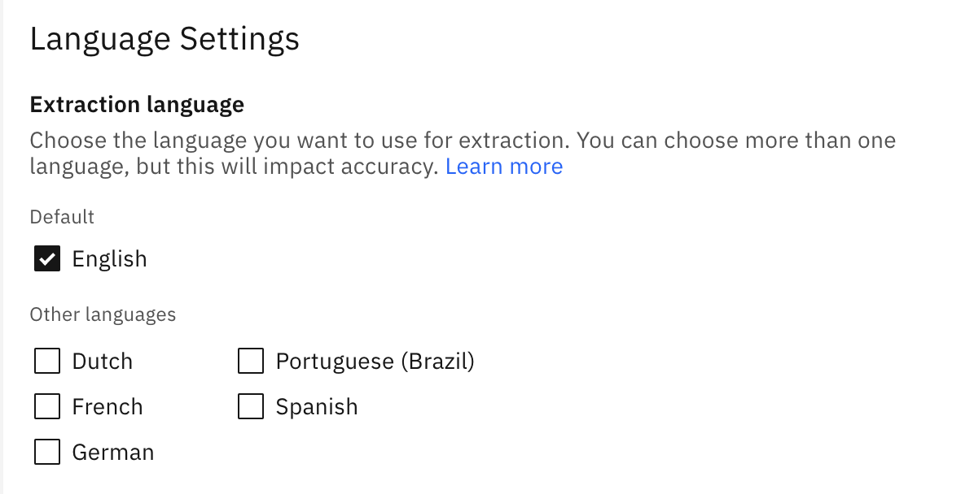
Language support
6 languages now supported
English
French
Spanish
German
Dutch
Portuguese
Tech preview – other languages
Can enable other languages for testing
Some features may not work TB

Slide 15
Next 90 days (~September) Primary goal: Successful POC in 3-days
Assets in development
Up to 6 production ready doc types
Self-serve form extractor for testing samples
Datacap integration to ADP sample app
Product Mgmt
Datacap sales play
Target existing Datacap customers
Clarify messaging / branding / pricing
Define use cases
Opportunity support team
Dedicated support team
Whatever it takes attitude
#automation-document-processing-techsales

Slide 16
Next 90 days (~September) Primary goal: Successful POC in 3-days
Partner rollout
Wide distribution to partners
Training materials
Techzone
Pre-trained classes
Demo scripts
Detailed instructions for Datacap integration
Faster training
Other items
Import/export full projects (share/backups etc)
Tech preview for more languages
…later in the year…
Smaller footprint
Portable containers
All in 1 Datacap/ADP techzone image

Slide 17
SELLER GUIDANCE SLIDE – Key Strengths:
Automation Document Processing
Datacap
Easy to train and configure a system without data science or capture expertise (business owners can build their own solutions in a matter of days / weeks)
Processing English, Spanish, and French documents (forms, statements, simple tables)
Infusing AI throughout document processing for faster development cycles:
Extracting data fields from documents using AI
Machine learning, AI-based document classification
AI-based OCR corrections
No need for templates / fingerprints
Built-in content management for retaining and managing processed documents
Highly customizable
Processing many different languages (support for 50+)
Processing handwriting
Extracting data from zoned fields (documents with a lot of checkboxes, complex lists)
Extracting information from complex / line-item tables (with add-ons like Datacap Accelerator)
Ingesting from multiple channels / methods and customizing export options
External data lookup and validation (API and DB)
Document separation (splitting / joining documents together)
Information on Datacap Accelerator
Internal and Business Partner Use Only
Notes:
This seller guidance slide provides key strengths for the document processing components of Cloud Pak for Business Automation which includes Automation Document Processing and Datacap.
For guidance on specific deals, contact one of the following:
Dan Ouimet (douimet@ca.ibm.com)
Jay Boileau (boileau@ca.ibm.com)
Ben Antin (bantin@us.ibm.com)
Tod DeBie (tod@ibm.com)
Sydney Adams (Sydney.Adams@ibm.com)

Slide 18
When Automation Document Processing does not meet all needs:
BUDGET, INFRASTRUCTURE, USE CASE, + FUNCTIONALITY REVIEW PASSES, BUT….
Insufficient budget, no containers, small volumes, need for maximum control over extraction, and / or OOTB integration
SELL....
Datacap OR Datacap Accelerator
NEED FLEXIBILITY TO USE ANY OF THE TOOLS IN EITHER ADP OR DATACAP
Need a combination of the key strengths
SELL….
Automation Document Processing AND Datacap WITH Expert Labs Connector
Internal and Business Partner Use Only
Notes:
This seller guidance slide provides a flow chart with general guidance and options for when to sell Automation Document Processing and Datacap.
For guidance on specific deals, contact one of the following:
Dan Ouimet (douimet@ca.ibm.com)
Jay Boileau (boileau@ca.ibm.com)
Ben Antin (bantin@us.ibm.com)
Tod DeBie (tod@ibm.com)
Sydney Adams (Sydney.Adams@ibm.com)

Slide 19
How to get help
Slack:
#datacap-smes - https://ibm-cloud.slack.com/archives/C16EU7BAT
#automation-document-processing-techsales - https://ibm-cloud.slack.com/archives/C01CH7WCZQS
#automation-document-processing-sales - https://ibm-cloud.slack.com/archives/C01D73D8BBJ
Center of competency: https://ibm.box.com/v/CaptureCenterOfCompetency
Seismic
https://ibm.seismic.com/Link/Content/DCCTM3fQT3V8MG9Qb6dGhQTjVhDj
https://ibm.seismic.com/Link/Content/DCFQWgP4dpPBjGCPj9DfR46qFPpj

